Slide 1
HOSPITAL MANAGEMENT SYSTEM
DONE BY : PRANAY SAMPAT
NU ID : 001617266

Slide 2
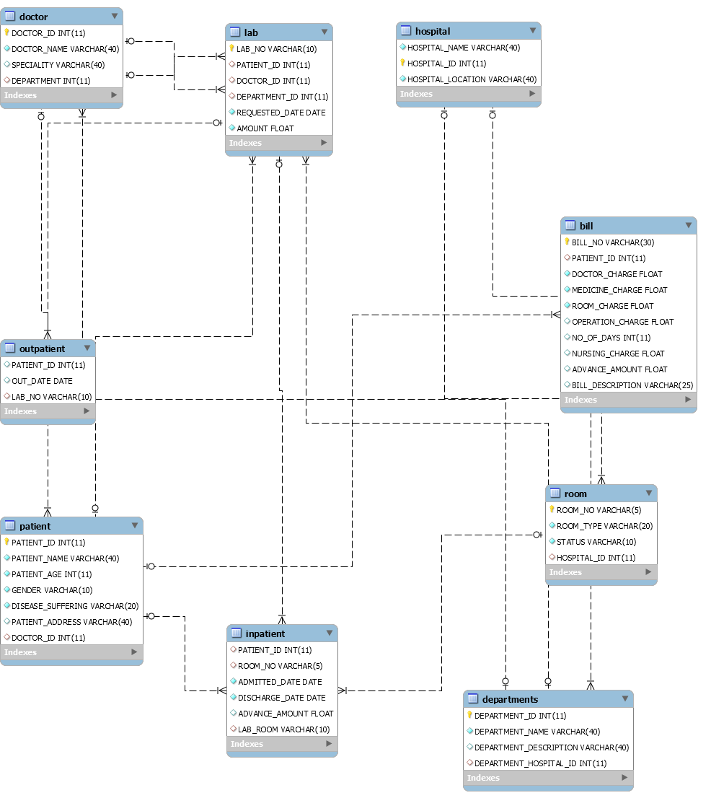
ER DIAGRAM

Slide 3
SCRIPT FOR CREATING A TABLE
CREATE TABLE HOSPITAL(
HOSPITAL_NAME VARCHAR(40) NOT NULL UNIQUE,
HOSPITAL_ID INT PRIMARY KEY,
HOSPITAL_LOCATION VARCHAR(40) NOT NULL);
VARCHAR AND INT ARE THE DATATYPE WE NEED TO DEFINE OR ASSIGN TO COLUMNS OF TABLE
PRIMARY KEY IS NON NULL UNIQUE VALUE OF A COLUMN WHICH IDENTIFIES OR IS BEING USED TO IDENTIFY THE TABLE.

Slide 4
SCRIPT FOR CREATING TABLE AND ADDING FOREIGN KEY CONSTRAINT
CREATE TABLE DEPARTMENTS(
DEPARTMENT_ID INT PRIMARY KEY,
DEPARTMENT_NAME VARCHAR(40) NOT NULL,
DEPARTMENT_DESCRIPTION VARCHAR(40),
DEPARTMENT_HOSPITAL_ID INT,
FOREIGN KEY (DEPARTMENT_HOSPITAL_ID) REFERENCES HOSPITAL(HOSPITAL_ID));
HERE DEPARTMENT_HOSPITAL_ID IS FOREIGN KEY FOR HOSPITAL_ID OF HOSPITAL
AND IS USED BY USING REFERENCES WORD

Slide 5
INSERT VALUES INTO TABLE
We can either import from excel or use insert command In sql.
Syntax example for insert values:
insert into patient values('53547','Tucker Wade','78','M','Blood Clotting','Ap #843-836 In Ave','462') ;
INSERT INTO LAB VALUES('LAB1','12676','482','24577','42319','120.51') ;

Slide 6
Using the use and drop command
These are two important commands in sql
Use Command : use to query by using particular database, lets say I need to use a database like hospital management then the syntax I will use is
use hospitalmanagement;
And then ill write or execute the queries, with this command all the queries will be executed under database name hospital management.
Drop Command : Drop command is used to drop table, database and colums. The syntax are as follows :
drop table table_name eg : drop lab or drop database hospitalmanagement

Slide 7
Writing a sql query using group by clause
The GROUP BY statement is used in conjunction with the aggregate functions to group the result-set by one or more columns.
select DOCTOR_NAME, COUNT(BILL_NO) AS NUMBER_OF_BILL_GENRATED_BY_DOC,SUM(BILL.OPERATION_CHARGE + BILL.DOCTOR_CHARGE) AS BILL_REVENUE_GENERATED_BY_DOCTOR from BILL LEFT JOIN DOCTOR ON BILL.DOCTOR_ID = DOCTOR.DOCTOR_ID GROUP BY DOCTOR_NAME

Slide 8
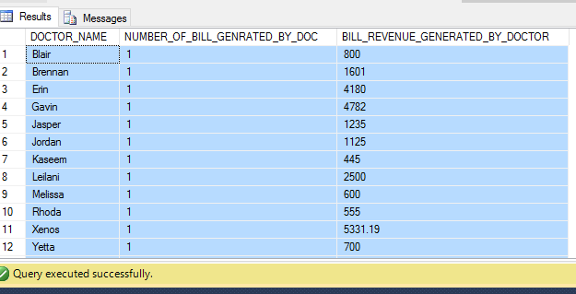
Output to group by clause
Here the output shows number of bills and revenue generated by a particular doctor

Slide 9
Order by clause
The ORDER BY keyword is used to sort the result-set by one or more columns.
The ORDER BY keyword sorts the records in ascending order by default. To sort the records in a descending order, you can use the DESC keyword.
select BILL_NO,DOCTOR_ID, DOCTOR_CHARGE,ROOM_CHARGE,ADVANCE_AMOUNT,NURSING_CHARGE from BILL order by DOCTOR_CHARGE desc

Slide 10
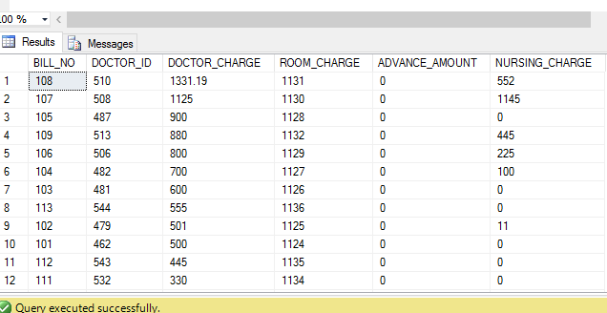
Output TO ORDER BY CLAUSE
HERE IS THE OUTPUT WHICH ORDERS BY DOCTOR CHARGE IN A BILL IN DESCENDING ORDER.

Slide 11
Sql FUNCTIONS
SQL aggregate functions return a single value, calculated from values in a column.
BASICS SQL FUNCTIONS ARE AS FOLLOWS :
AVG() - Returns the average value
COUNT() - Returns the number of rows
FIRST() - Returns the first value
LAST() - Returns the last value
MAX() - Returns the largest value
MIN() - Returns the smallest value
SUM() - Returns the sum

Slide 12
Avg() fUNCTION
The AVG() function returns the average value of a numeric column.
EXAMPLE :
SELECT AVG(ROOM_CHARGE) AS AVERAGE_ROOM_COST FROM BILL
OUTPUT : THIS WILL GIVE THE AVERAGE ROOM COST IN AN HOSPITAL
AVERAGE_ROOM_COST
1130

Slide 13
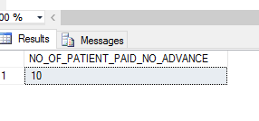
coUNT() fUNCTION
The COUNT() function returns the number of rows that matches a specified criteria.
EXAMPLE :
SELECT COUNT(PATIENT_ID) AS NO_OF_PATIENT_PAID_NO_ADVANCE FROM INPATIENT WHERE ADVANCE_AMOUNT = 0
OUTPUT : RETURNS THE COUNT OF NO OF PATIENTS WHO HAVE PAID NO ADVANCE AMOUNT TO A LAB.

Slide 14
FIRST() FUNCTION
The FIRST() function returns the first value of the selected column.
EXAMPLE : SELECT TOP 1 PATIENT.PATIENT_NAME FROM PATIENT,DOCTOR WHERE PATIENT.DOCTOR_ID = DOCTOR.DOCTOR_ID
RETURNS THE TOP MEANING FIRST VALUE OF THE COLUMN
OUTPUT :
PATIENT_NAME
TUCKER WADE

Slide 15
Max() AND min() fUNCTIONS
The MAX() function returns the largest value of the selected column.
EXAMPLE : SELECT MAX(ROOM_CHARGE) AS MAXIMUM_ROOM_CHARGE FROM BILL
The MIN() function returns the smallest value of the selected column.
SELECT MAX(ROOM_CHARGE) AS MAXIMUM_ROOM_CHARGE, MIN(ROOM_CHARGE) AS MINIMUM_ROOM_CHARGE FROM BILL
MAXIMUM_ROOM_CHARGE MINIMUM_ROOM_CHARGE
1136 1124

Slide 16
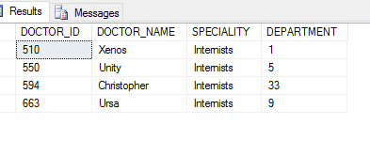
And or functions
OR Function :For the row to be selected at least one of the conditions must be true
Example :select * from doctor where speciality ='Hematologist' or speciality ='Internists'
OUTPUT :

Slide 17
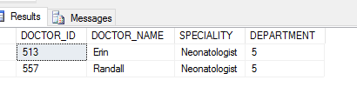
AND Function (CONT)
The AND operator displays a record if both the first condition AND the second condition are true.
Example :select * from DOCTOR where SPECIALITY like '%Neo%' AND DEPARTMENT ='5'
Output :

Slide 18
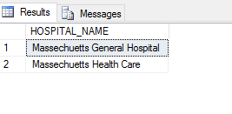
HAVING FUNCTION
The HAVING clause was added to SQL because the WHERE keyword could not be used with aggregate functions.
Example : SELECT HOSPITAL_NAME FROM DEPARTMENTS INNER JOIN HOSPITAL ON DEPARTMENT_HOSPITAL_ID = HOSPITAL.HOSPITAL_ID WHERE HOSPITAL_NAME LIKE 'M%' GROUP BY HOSPITAL_NAME HAVING COUNT (DEPARTMENT_ID)>3
OUTPUT :

Slide 19
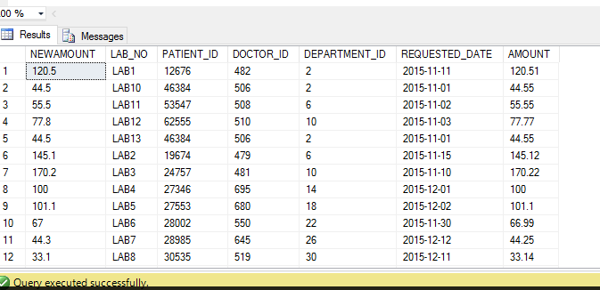
Round()
The ROUND() function is used to round a numeric field to the number of decimals specified.
EXAMPLE : SELECT ROUND(AMOUNT,1) AS NEWAMOUNT ,* FROM LAB
OUTPUT :

Slide 20
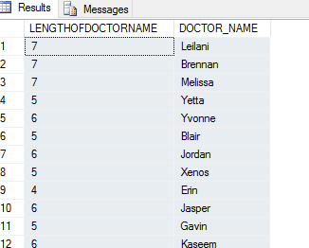
Len()
The LEN() function returns the length of the value in a text field.
EXAMPLE : SELECT LEN(DOCTOR_NAME) AS LENGTHOFDOCTORNAME, DOCTOR_NAME FROM DOCTOR
OUTPUT :

Slide 21
INNER JOIN
The INNER JOIN keyword selects all rows from both tables as long as there is a match between the columns in both tables.
CODE :
SELECT INPATIENT.PATIENT_ID,PATIENT.PATIENT_NAME,PATIENT_ADDRESS,PATIENT_AGE,ROOM_NO,ROOM_CHARGE,ADMITTED_DATE,DISCHARGE_DATE,BILL_NO,DOCTOR_CHARGE,MEDICINE_CHARGE,DOCTOR_CHARGE,NURSING_CHARGE AS TOTAL_BILL FROM INPATIENT INNER JOIN BILL ON INPATIENT.PATIENT_ID = BILL.PATIENT_ID INNER JOIN PATIENT ON INPATIENT.PATIENT_ID = PATIENT.PATIENT_ID

Slide 22
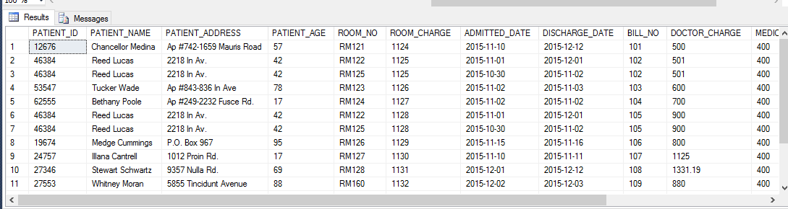
OUTPUT FOR INNER JOIN

Slide 23
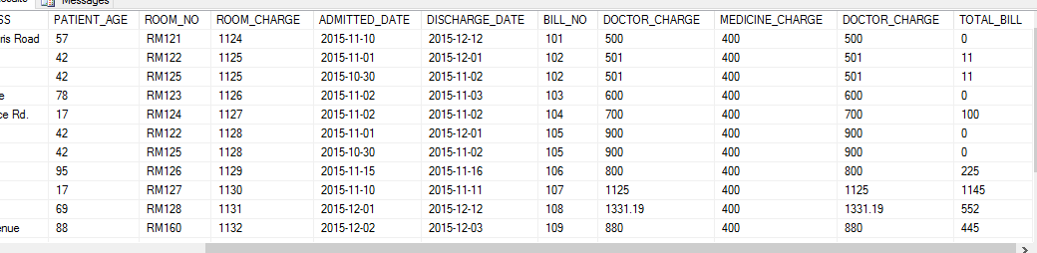
OUTPUT INNER JOIN CONT..

Slide 24
LEFT JOIN
The LEFT JOIN keyword returns all rows from the left table (PATIENT), with the matching rows in the right table (INPATIENT). The result is NULL in the right side when there is no match.
SELECT PATIENT.PATIENT_ID, PATIENT_NAME,PATIENT.PATIENT_AGE,ADMITTED_DATE,DISCHARGE_DATE,ROOM_NO,LAB_ROOM FROM PATIENT LEFT JOIN INPATIENT ON PATIENT.PATIENT_ID = INPATIENT.PATIENT_ID

Slide 25
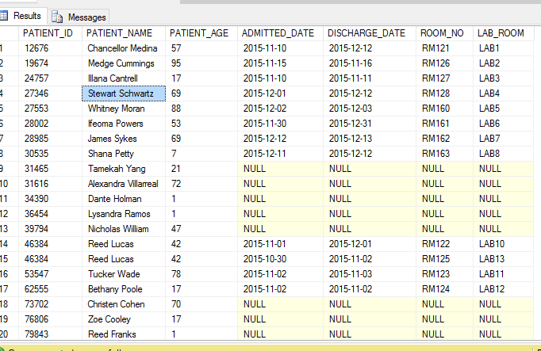
OUTPUT LEFT JOIN

Slide 26
RIGHT JOIN
The RIGHT JOIN keyword returns all rows from the right table (ROOM), with the matching rows in the left table (INPATIENT). The result is NULL in the left side when there is no match.
SELECT PATIENT_ID,ROOM.ROOM_NO,ROOM_TYPE,HOSPITAL.HOSPITAL_ID,HOSPITAL_NAME FROM INPATIENT RIGHT JOIN ROOM ON INPATIENT.ROOM_NO = ROOM.ROOM_NO INNER JOIN HOSPITAL ON ROOM.HOSPITAL_ID = HOSPITAL.HOSPITAL_ID

Slide 27
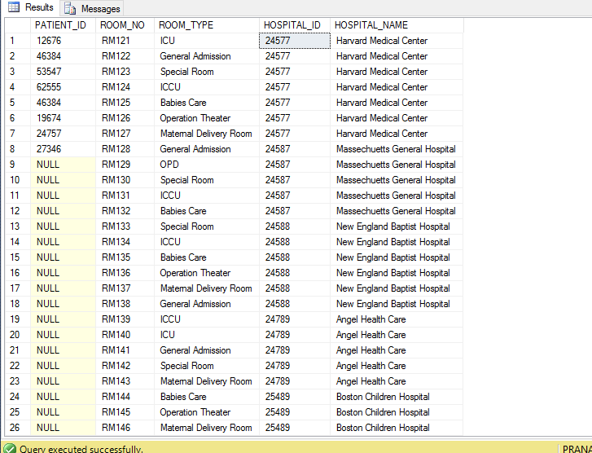
OUTPUT RIGHT JOIN

Slide 28
FULL JOIN
The FULL OUTER JOIN keyword returns all rows from the left table (PATIENT) and from the right table (INPATIENT).
CODE: SELECT PATIENT.PATIENT_ID,PATIENT.PATIENT_NAME,PATIENT.PATIENT_ADDRESS,DOCTOR_ID,ADMITTED_DATE,DISCHARGE_DATE FROM PATIENT FULL OUTER JOIN INPATIENT ON PATIENT.PATIENT_ID = INPATIENT.PATIENT_ID

Slide 29
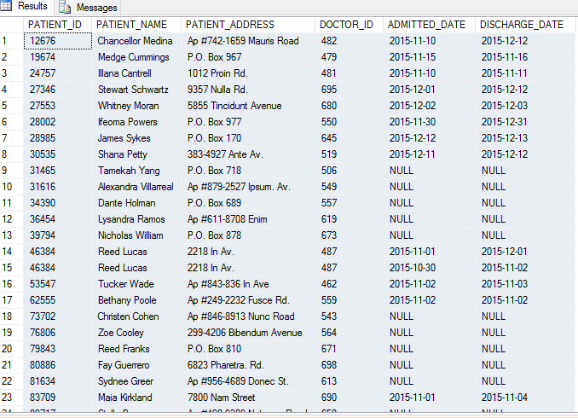
OUTPUT FULL OUTER JOIN

Slide 30
CROSS JOIN
The SQL CROSS JOIN produces a result set which is the number of rows in the first table multiplied by the number of rows in the second table, if no WHERE clause is used along with CROSS JOIN. This kind of result is called as Cartesian Product.
CODE :
SELECT PATIENT.PATIENT_ID,PATIENT.PATIENT_NAME,PATIENT.DOCTOR_ID,BILL_NO,DISEASE_SUFFERING FROM PATIENT CROSS JOIN BILL

Slide 31
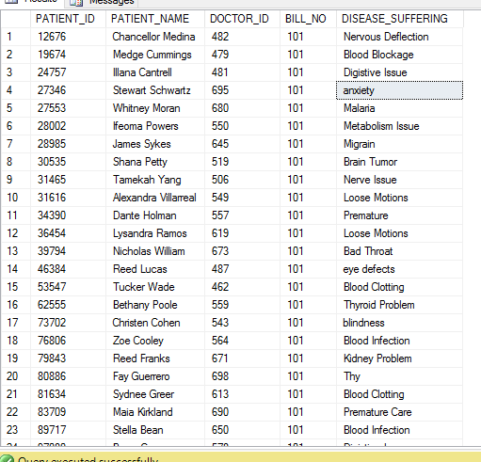
OUTPUT FOR CROSS JOIN

Slide 32
QUERIES AND SUBQUERIES
SQL queries is the method to extract data from database.
A Subquery or Inner query or Nested query is a query within another SQL query and embedded within the WHERE clause.
A subquery is used to return data that will be used in the main query as a condition to further restrict the data to be retrieved.
Subqueries can be used with the SELECT, INSERT, UPDATE, and DELETE statements along with the operators like =, <, >, >=, <=, IN, BETWEEN etc.
Subqueries must be enclosed within parentheses.
A subquery can have only one column in the SELECT clause, unless multiple columns are in the main query for the subquery to compare its selected columns.

Slide 33
SQL Subqueries
CODE :
select PATIENT_ID,BILL_NO,DOCTOR_CHARGE,MEDICINE_CHARGE,ROOM_CHARGE,OPERATION_CHARGE,DOCTOR_ID from Bill where PATIENT_ID in(select PATIENT_ID from BILL where DOCTOR_CHARGE > 500)
Returns all the patient who have doctor charge which is more than 500.

Slide 34
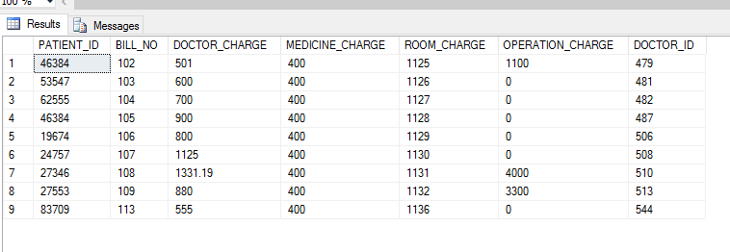
SQL Subqueries output

Slide 35
Sql complex queries
select PATIENT.PATIENT_ID,PATIENT.PATIENT_NAME,BILL_NO,DOCTOR_CHARGE,MEDICINE_CHARGE,NURSING_CHARGE,OPERATION_CHARGE,ROOM_CHARGE,DOCTOR.DOCTOR_ID,DOCTOR_NAME,HOSPITAL.HOSPITAL_NAME from PATIENT inner join BILL on PATIENT.PATIENT_ID = BILL.PATIENT_ID inner join DOCTOR on BILL.DOCTOR_ID = DOCTOR.DOCTOR_ID inner join DEPARTMENTS on DOCTOR.DEPARTMENT = DEPARTMENTS.DEPARTMENT_ID inner join HOSPITAL on DEPARTMENTS.DEPARTMENT_HOSPITAL_ID = HOSPITAL.HOSPITAL_ID
The above query will equate patient and bill and provide department as well as hospital name.

Slide 36
USER ACCOUNTS AND PRIVELEGES
TO CREATE THE USERS WE CAN USE FOLLOWING COMMAND IN SQL SERVER
CREATE USER [TESTER] FOR LOGIN [TESTER] WITH DEFAULT_SCHEMA=[dbo]
GO

Slide 37
USER PRIVELAGES
CREATE LOGIN ADMIN WITH PASSWORD = 'ADMIN' ; CREATE USER ADMIN CREATE LOGIN USER1 WITH PASSWORD = 'USER1' ; CREATE USER USER1 CREATE LOGIN DEVELOPER WITH PASSWORD = 'DEVELOPER' ; CREATE USER DEVELOPER CREATE LOGIN TESTER WITH PASSWORD = 'TESTER' ; CREATE USER TESTER --to get all users SELECT * FROM sys.database_principals --to grant all access GRANT ALL ON BILL TO ADMIN
GRANT SELECT, INSERT, UPDATE ON BILL TO USER1
GRANT SELECT, INSERT, UPDATE, DELETE,ALTER ON BILL TO DEVELOPER
GRANT SELECT ON BILL TO TESTER
REVOKE INSERT,UPDATE ON CUSTOMER FROM USER1;
REVOKE INSERT,UPDATE ON BILL FROM USER1;

Slide 38
Stored procedures
Stored Procedure in SQL Server can be defined as the set of logical group of SQL statements which are grouped to perform a specific task. There are many benefits of using a stored procedure. The main benefit of using a stored procedure is that it increases the performance of the database.The other benefits of using the Stored Procedure are given below.
Basic checklist while creating stored procedure :
CREATE PROCEDURE statements cannot be combined with other SQL statements in a single batch.
To create procedures, you must have CREATE PROCEDURE permission in the database and ALTER permission on the schema in which the procedure is being created. For CLR stored procedures, you must either own the assembly referenced in <method_specifier>, or have REFERENCES permission on that assembly.
Stored procedures are schema-scoped objects, and their names must follow the rules for identifiers.
You can create a stored procedure only in the current database.

Slide 39
Store procedure code : DATA ENTRY STORED PROCEDURE
use HospitalManagement
GO
create procedure dbo.create_hospital
@hospital_name varchar(40),
@hospital_id int,
@hospital_location varchar(40)
AS BEGIN TRY
insert into HOSPITAL
values (@hospital_name,@hospital_id,
@hospital_location);END TRY
BEGIN CATCH
PRINT 'This is the error: ' + error_message()
END CATCH
GO

Slide 40
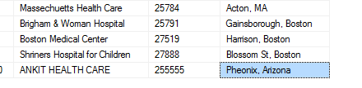
Execution code and output
Execute dbo.create_hospital
@hospital_name = 'ANKIT HEALTH CARE',
@hospital_id ='255555',
@hospital_location ='Pheonix, Arizona‘
Output :

Slide 41
Stored procedure example 2
use HospitalManagement
Go
create procedure dbo.patient_details
@patient_id int
AS
BEGIN TRY
SELECT PATIENT.PATIENT_ID,PATIENT_NAME,PATIENT.DISEASE_SUFFERING,DOCTOR.DOCTOR_ID,DOCTOR.DOCTOR_NAME,DOCTOR.SPECIALITY,HOSPITAL.HOSPITAL_NAME,HOSPITAL_LOCATION,DOCTOR_CHARGE,ROOM_NO,ROOM_CHARGE FROM PATIENT,INPATIENT,BILL,DOCTOR,DEPARTMENTS,HOSPITAL where PATIENT.PATIENT_ID ISNULL(@patient_id,PATIENT.PATIENT_ID) and PATIENT.PATIENT_ID = INPATIENT.PATIENT_ID AND INPATIENT.PATIENT_ID = BILL.PATIENT_ID AND BILL.DOCTOR_ID = DOCTOR.DOCTOR_ID AND DOCTOR.DEPARTMENT = DEPARTMENTS.DEPARTMENT_ID AND DEPARTMENT_HOSPITAL_ID = HOSPITAL.HOSPITAL_IDEND TRY
BEGIN CATCH
PRINT 'This is the error: ' + error_message()
END CATCH
GO

Slide 42
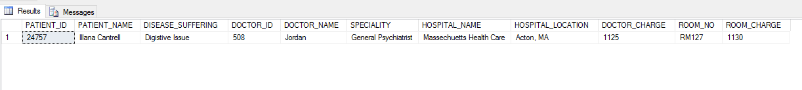
Stored procedure 2 process
Stored procedure take patients id and provides with all the details about the bill hospital admitted.
exec dbo.patient_details @patient_id ='24757‘
Output :

Slide 43
Commit transactions
As a SQL language we use transaction control language very frequently. Committing a transaction means making permanent the changes performed by the SQL statements within the transaction. A transaction is a sequence of SQL statements that Oracle Database treats as a single unit. This statement also erases all save points in the transaction and releases transaction locks.

Slide 44
Code for commit transaction
USE HospitalManagement;
GO
BEGIN TRANSACTION;
GO
DELETE FROM HospitalManagement.dbo.BILL
WHERE BILL_NO = 109;
GO
COMMIT TRANSACTION;
GO
The following commit transaction will delete from table bill where bill no is 109

Slide 45
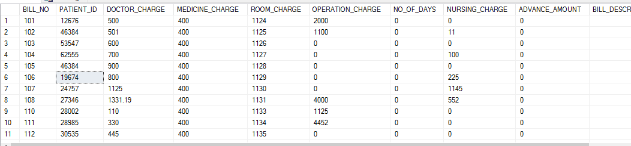
Output after commit
Here we can see that currently bill no with 109 has been deleted from table

Slide 46
Roll Back Transactions
Rolls back an explicit or implicit transaction to the beginning of the transaction, or to a savepoint inside the transaction. You can use ROLLBACK TRANSACTION to erase all data modifications made from the start of the transaction or to a savepoint. It also frees resources held by the transaction.

Slide 47
Code for roll back transaction
USE HospitalManagement;
GO
DECLARE @TransactionName varchar(20) = 'Transaction1';
BEGIN TRAN @TransactionName
insert into bill values('109','27553','880','400','1132','3300','','445','','','513')
ROLLBACK TRAN @TransactionName;
insert into bill values('109','27553','880','400','1132','3300','','445','','','513')
SELECT * FROM BILL;

Slide 48
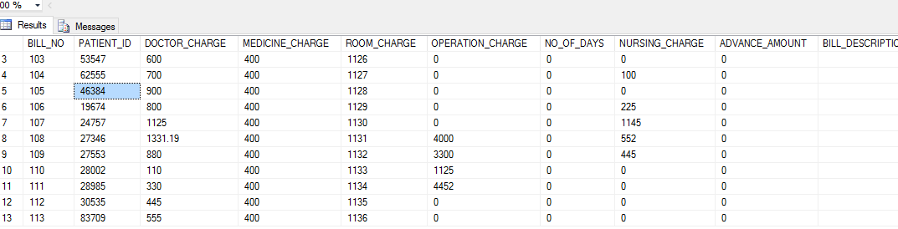
Output for rollback
Here we can see that the transaction is completely rolled back

Slide 49
ROLLBACK TRANSACTION SAVE POINT
ROLLBACK TRANSACTION SAVE POINT RECOVERS THE TRANSACTION FROM SAVE POINT AND HELPS MAINTAING THE DATA DELETED.
CODE USED :
BEGIN TRANSACTION
SAVE TRANSACTION POINT1;
DELETE FROM BILL WHERE BILL_NO = 108 -- DELETES THE RECORD WITH BILL_NO 108
SELECT * FROM BILL
ROLLBACK TRANSACTION POINT1 RECOVERS THE DELETED TRANSACTION

Slide 50
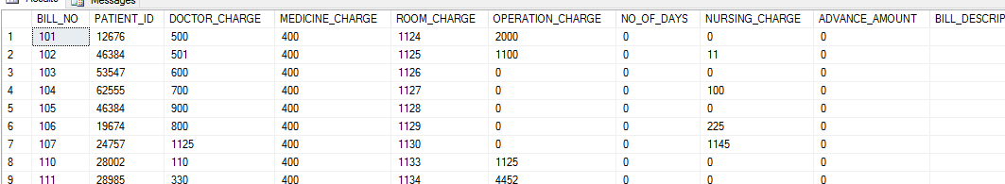
OUTPUT AFTER DELETING

Slide 51
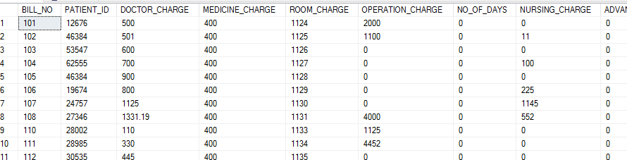
OUTPUT AFTER ROLLBACK OF SAVEPOINT

Slide 52
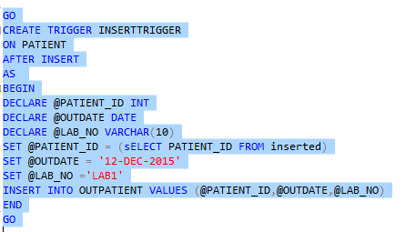
Insert TRIGGER
INSERT trigger defined on a table and an INSERT is executed. A row is not added to the table, but the code in the trigger is fired. The following shows what this looks like.
Code :

Slide 53

Output before inserting trigger
select count(*) from OUTPATIENT
10
As soon as you insert into Patient
insert into patient values('453681','Ruchi Goyal','25','F','Anix','11 Parker Hill','671')
After trigger the output is

Slide 54
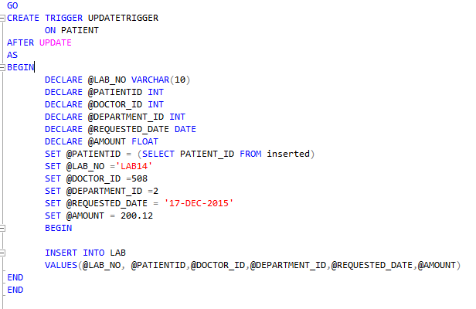
Update trigger
An UPDATE trigger is used to perform an action after an update is made on a table.
CODE :

Slide 55
EXPLANATION FOR ABOVE ATTACHED CODE
The trigger will be fired every time when you update the record in Patient Table
The basic thing trigger is will do for every update made on table patient, trigger will create a corresponding record of patient id in lab table with specified sets of value.

Slide 56
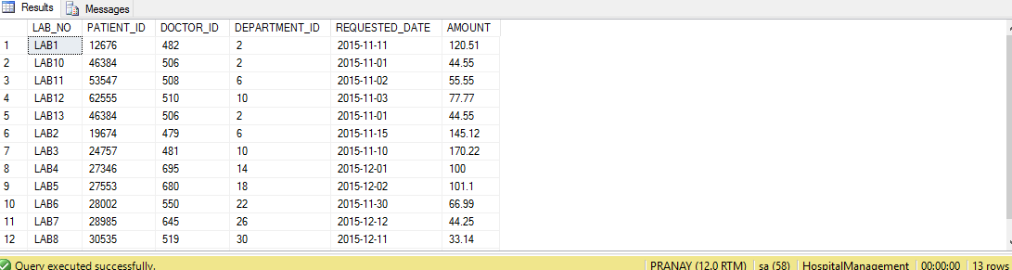
Output before firing a trigger on lab table
As we can see there are 13 records in lab table before firing a trigger

Slide 57
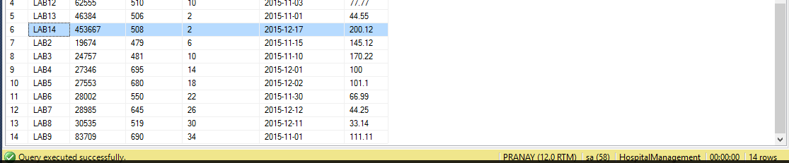
Output after trigger
update PATIENT set PATIENT_ID='453667' where PATIENT_ID ='4536'
Now once I have fired the trigger see the output rows the records have been incremented.

Slide 58
Delete trigger
DELETE IS ANOTHER TYPE OF TRIGGER WHEN APPLIED TO PARTICULAR TABLE THE RECORD IN SUBSQUENT TRIGGER QUERY WILL BE DELETED.
DELETE TRIGGER IS USEFUL WHEN THERE IS ONE TO ONE RECORD MAPPING IN EACH TABLE OR MULTIPLE BECAUSE IT WILL SIMPLY DELETE ALL THE RECORDS FIRED IN TRIGGERED.

Slide 59
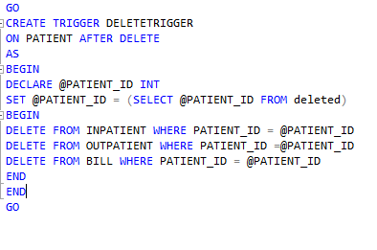
CODE FOR DELETE TRIGGER
THE CODE HERE WILL BASICALLY DELETE THE RECORDS OF PATIENTS FROM INPATIENT,OUTPATIENT AND BILL WHEN A PARTICULAR PATIENT IS DELETED FROM PATIENT TABLE

Slide 60
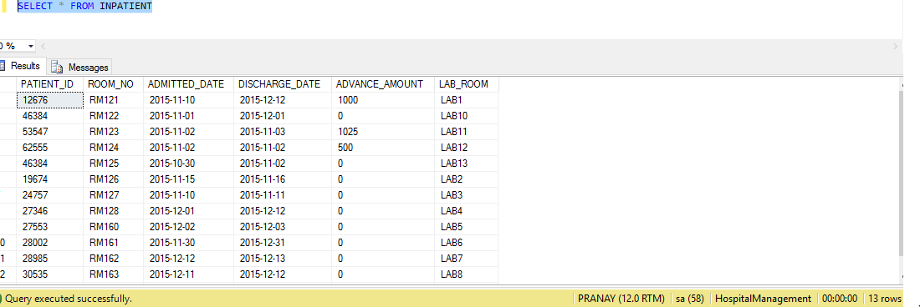
OUTPUT BEFORE DELETE TRIGGER
IN PATIENT TABLE

Slide 61
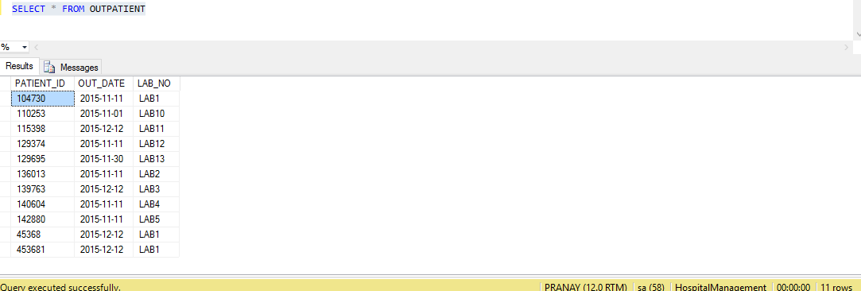
OUTPUT BEFORE TRIGGER
OUTPATIENT TABLE

Slide 62
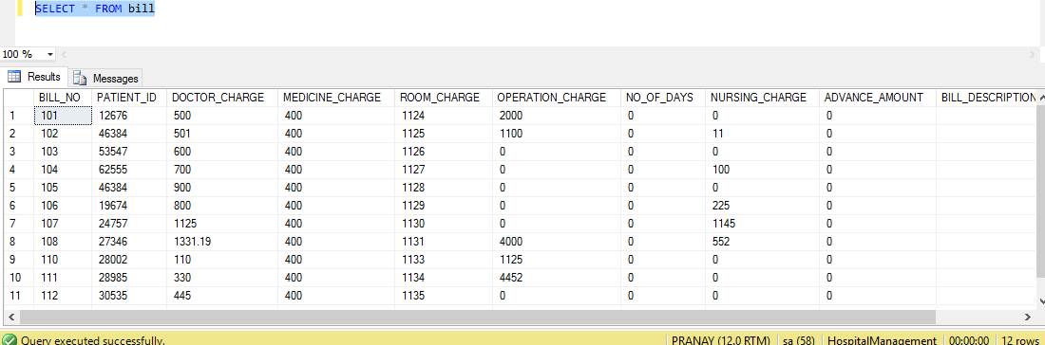
OUTPUT BEFORE DELETE TRIGGER
BILL TABLE

Slide 63

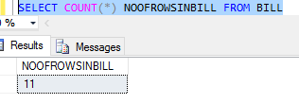
OUTPUT AFTER TRIGGER
DELETE FROM PATIENT WHERE PATIENT_ID ='62555'
OUTPUT FROM INPATIENT TABLE
BILL TABLE

Slide 64
VIEWS
In SQL, a view is a virtual table based on the result-set of an SQL statement.
A view contains rows and columns, just like a real table. The fields in a view are fields from one or more real tables in the database.
You can add SQL functions, WHERE, and JOIN statements to a view and present the data as if the data were coming from one single table.

Slide 65
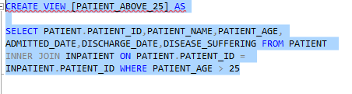
View 1 : finding the patient above age 25 admitted to hospital
CODE :

Slide 66
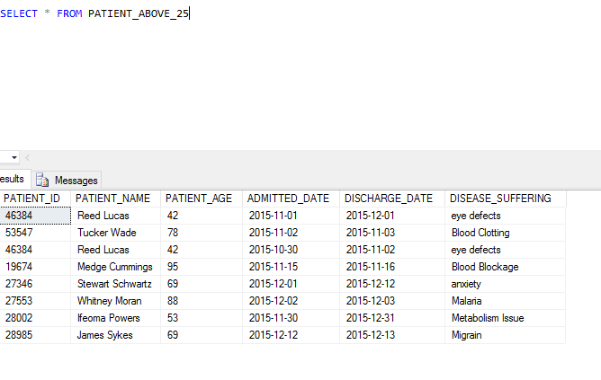
Output for view 1

Slide 67
View 2 : To find each hospital has how many number of patients and their details
CREATE VIEW HOSPITAL_WISE_PATIENT_DETAIL AS
SELECT HOSPITAL_NAME,HOSPITAL_ID,HOSPITAL_LOCATION,DOCTOR.DOCTOR_ID,
DOCTOR_NAME,SPECIALITY,BILL_NO,PATIENT.PATIENT_ID, PATIENT.PATIENT_NAME,
PATIENT.DISEASE_SUFFERING FROM HOSPITAL INNER JOIN DEPARTMENTS ON
HOSPITAL.HOSPITAL_ID= DEPARTMENTS.DEPARTMENT_HOSPITAL_ID INNER JOIN DOCTOR ON DEPARTMENTS.DEPARTMENT_ID = DOCTOR.DEPARTMENT
INNER JOIN BILL ON DOCTOR.DOCTOR_ID = BILL.DOCTOR_ID INNER JOIN PATIENT ON BILL.PATIENT_ID = PATIENT.PATIENT_ID

Slide 68
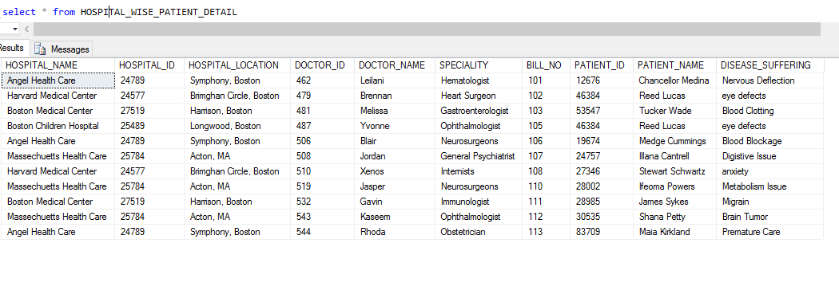
Output for view2

Slide 69
View3: will return all the patient will their bill charges and with operation charges above 500$
CREATE VIEW PATIENT_WHOSE_OPERATION_CHARGE_ABOVE_500$ AS
SELECT PATIENT.PATIENT_ID,PATIENT.PATIENT_NAME,DISEASE_SUFFERING,DOCTOR.DOCTOR_ID,DOCTOR_NAME,BILL_NO,MEDICINE_CHARGE,OPERATION_CHARGE,DOCTOR_CHARGE,NURSING_CHARGE FROM BILL INNER JOIN PATIENT ON
BILL.PATIENT_ID = PATIENT.PATIENT_ID INNER JOIN DOCTOR ON
BILL.DOCTOR_ID = DOCTOR.DOCTOR_ID WHERE OPERATION_CHARGE >500

Slide 70
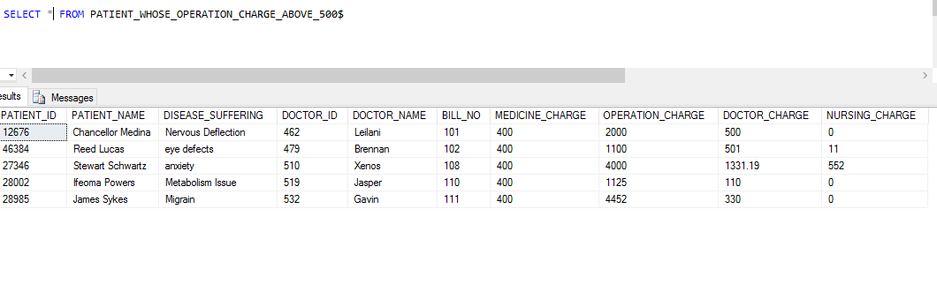
VIEW 3 : OUTPUT

Slide 71
Backup plan script
use HospitalManagement
GO
BACKUP DATABASE hospitalmanagement
TO DISK = 'C:\HOSPITAL_BACK.Bak'
WITH FORMAT,
MEDIANAME = 'Z_SQLServerBackups',
NAME = 'Full Backup of myInventoryMgmt';
GO

Slide 72
Back plan
1st Day will be FULL BACK UP
FOR 15 days increment backup
AGAIN A FULL BACKUP

Slide 73
What is data warehousing?
A data warehouse is relational database that is designed for query and analysis rather than for transaction processing.
It usually contains historical data derived from transactional data, but it can include data from another resources too.
The main purpose of using data warehouse is that it separates the transaction workload and allows any organization to collect the data from several resources.
Additionally to a relational database, a data warehouse environment includes an extraction, transportation, transformation and loading solutions.

Slide 74
Components of data warehouse
Data Warehouse Database : The central data warehouse is the main component of a data warehouse system. It is generally implemented on RDBMS technology
Sourcing, Acquisition, Cleanup and Transformation Tools : The data sourcing, cleanup, transformation and migration tools perform all of the conversions, summarizations, key changes, structural changes and condensations needed to transform disparate data into information that can be used by the decision support tool.
Meta Data : Meta data is data about data that describes the data warehouse. It is used for building, maintaining, managing and using the data warehouse. Meta data can be classified into:
Technical meta data, which contains information about warehouse data for use by warehouse designers and administrators when carrying out warehouse development and management tasks.
Business meta data, which contains information that gives users an easy-to-understand perspective of the information stored in the data warehouse.

Slide 75
Components of dw cont..
Access Tools : The principal of a data warehouse is to provide information to business users for strategic decision making. The users interact wih dw using access tools. Generally the access tools are classified as query and reporting tools, application development tools, online analytical tools, online analytical processing tools and data mining tools.
Data Marts : The concept of a data mart is causing a lot of excitement and attracts much attention in the data warehouse industry. Mostly, data marts are presented as an alternative to a data warehouse that takes significantly less time and money to build.
Information Delivery System : The information delivery component is used to enable the process of subscribing for data warehouse information and having it delivered to one or more destinations according to some user-specified scheduling algorithm.

Slide 76
ETL (EXTRACT TRANSFORM LOAD)
Extract : The first part of ETL process involves extracting the data from data source systems. Most data warehousing consolidate the data from different sources which will consist different format of data as different systems have different data formats.
An intrinsic part of the extraction involves data validation to confirm whether the data pulled from the sources has the correct/expected values in a given domain (such as a pattern/default or list of values).

Slide 77
ETL CONT….
Transform : In data transformation stage series of rules and function are applied to extracted data in order to prepare the data to be loaded into end target.
An important function of transformation is the cleaning of data which aims to pass only the proper data.
The various steps at transformation level include : selecting only certain columns to load, sorting and ordering the data, joining the data, aggregating , transposing etc

Slide 78
ETL CONT…
LOAD : The load phase loads the data into the end target that may be a simple delimited flat file or a data warehous Depending on the requirements of the organization, this process varies widely. Some data warehouses may overwrite existing information with cumulative information; updating extracted data is frequently done on a daily, weekly, or monthly basis.

Slide 79
What is business intelligence ?
Business Intelligence is an umbrella term that refers to a variety of software applications used to analyze an organization raw data.
Business Intelligence is the division made up of several related activities, including data mining, online analytical processing, querying and reporting.
Companies use BI to improve decision making, cut cost and identify new business opportunities.
Business Intelligence can also be coined as giving business value to extracted data from a companies data warehouse.

Slide 80
Difference between dw and bi
DW is the raw database where in the data is collected from various sources and business intelligence is tool to analyze the data collected from data warehouse after the ETL process.
DW is unstructured and raw database whereas BI is organized and structured tool.
DW is used for storing the historical data whereas BI is used to give business value to unstructured data stored in database.

Slide 81
What is unstructured database ?
AN unstructured database is the database which allows the data from various sources to be stored within the database irrelevant of their relationship which was constraint with RDBMS.
The various unstructured databases include NoSQL, Hadoop , Mango DB etc.
RDBMS used to offer a stable and flexible data, but with the proliferation in data generation to stored the data in structured way is next to impossible, hence an unstructured database was the need of day.

Slide 82
Comparison between an unstructured and structured database
Lets see the difference between an SQL and NoSql Databse :
Structure and type of data being kept :SQL/Relational databases require a structure with defined attributes to hold the data, unlike NoSQL databases which usually allow free-flow operations.
Querying :Regardless of their licences, relational databases all implement the SQL standard to a certain degree and thus, they can be queried using the Structured Query Language (SQL). NoSQL databases, on the other hand, each implement a unique way to work with the data they manage.
Scailing : Both solutions are easy to scale vertically (i.e. by increasing system resources). However, being more modern (and simpler) applications, NoSQL solutions usually offer much easier means to scale horizontally

Slide 83
Comparison cont..
Reliability : When it comes to data reliability and safe guarantee of performed transactions, SQL databases are still the better bet.
Support : Relational database management systems have decades long history. They are extremely popular and it is very easy to find both free and paid support. If an issue arises, it is therefore much easier to solve than recently-popular NoSQL databases -- especially if said solution is complex in nature (e.g. MongoDB).
Complex Data keeping and querying needs :By nature, relational databases are the go-to solution for complex querying and data keeping needs. They are much more efficient and excel in this domain.

Slide 84
What is mechanism behind secure delete in db?
Secure delete is not the actual delete from rows what basically happens is that delete is made to memory copy of data and then written onto log file in synchronous mode. Only at some later time is the record deleted from actual data file on disk.
Safe delete is the mechanism by which we delete the rows from table but the actual record still exists and can be roll back.
For any transaction to have safe delete the record can be rolled back using rolled back transaction saving point or commit

Slide 85
Steps to perform SAFE DELETE
Do an `UPDATE` on the rows to replace all data with blank data of the same length. So, if you've got `Polynomial` in a cell, you replace it with `AAAAAAAAAA`.
Delete the rows as normal.
Add a bunch of new rows with large-ish blobs of dummy data.
Delete those rows.
Take down the database and run a shrink / compact / re-index operation.

Slide 86
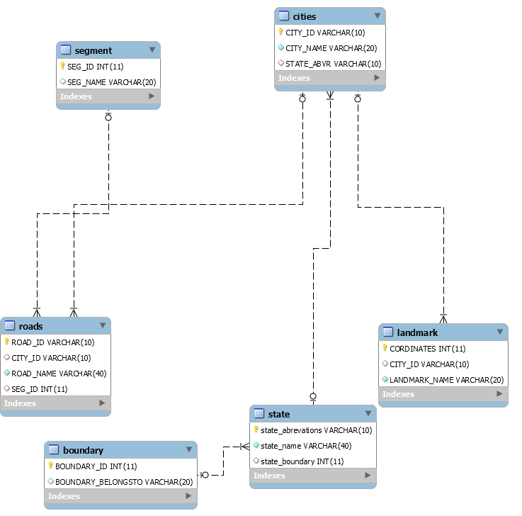
Er diagram

Slide 87
normalization
Database normalization is technique of organizing the data in database.
Normalization is a systematic approach of decomposing tables to eliminate data redundancy data redundancy and undesirable characteristics like insertion, update and delete anomalies.
Normalization is mainly used for two purpose :
Eliminating reduntant data
Ensuring data dependencies make sense i.e data is logically stored

Slide 88
1nf : First Normalization FORM
As per First Normal Form, no two Rows of data must contain repeating group of information i.e each set of column must have a unique value, such that multiple columns cannot be used to fetch the same row. Each table should be organized into rows, and each row should have a primary key that distinguishes it as unique.
The Primary key is usually a single column, but sometimes more than one column can be combined to create a single primary key. For example consider a table which is not in First normal form

Slide 89
1NF
Example 1 : lets consider a table
STUDENT AGE SUBJECT
ADAM 15 AED, DBMS
DAVIS 18 AED
PRANAY 25 AED, ALGORITHMS
THE 1NF OF THE ABOVE EXAMPLE
STUDENT AGE SUBJECT
ADAM 15 AED
ADAM 15 DBMS
DAVIS 18 AED
PRANAY 25 AED
PRANAY 25 ALGORITHMS

Slide 90
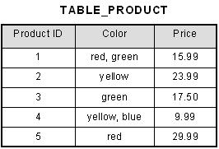
1NF CONT
PRODUCT ID COLOR PRICE
1 RED
15.99
1 GREEN 15.99

Slide 91
Second normal form
As per the Second Normal Form there must not be any partial dependency of any column on primary key. It means that for a table that has concatenated primary key, each column in the table that is not part of the primary key must depend upon the entire concatenated key for its existence. If any column depends only on one part of the concatenated key, then the table fails Second normal form.

Slide 92
Second Normal form example
STUDENT AGE SUBJECT
ADAM 15 MATHS,BIOLOGY
THE 2NF RESULT FOR ABOVE WILL BE
STUDENT AGE STUDENT SUBJECT
ADAM 15 ADAM MATHS
ADAM BIOLOGY

Slide 93
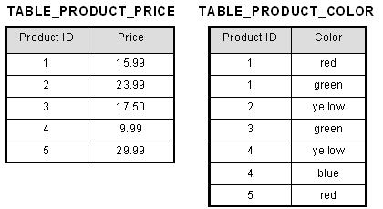
Second normal form example

Slide 94
3NF
Third Normal form applies that every non-prime attribute of table must be dependent on primary key, or we can say that, there should not be the case that a non-prime attribute is determined by another non-prime attribute. So this transitive functional dependency should be removed from the table and also the table must be in Second Normal form. For example, consider a table with following fields

Slide 95
3NF EXAMPLE
Student_id Student_name DOB Street city State Zip
THE ABOVE TABLE WILL BE NORMALIZED TO FOLLOWING FORM
NEW TABLES ARE AS FOLLOWS :
STUDENT_ID STUDENT_NAME DOB ZIP
ADDRESS TABLE
ZIP STREET CITY STATE

Slide 96
3.5 NF
Boyce and Codd Normal Form is a higher version of the Third Normal form. This form deals with certain type of anamoly that is not handled by 3NF. A 3NF table which does not have multiple overlapping candidate keys is said to be in BCNF. For a table to be in BCNF, following conditions must be satisfied:
R must be in 3rd Normal Form
and, for each functional dependency ( X -> Y ), X should be a super Key.

Slide 97
When to use normalization?
Data normalization helps you design new databases to meet these goals or to test databases to see whether they meet the goals. Sometimes database designers refer to these goals in terms such as data integrity, referential integrity, or keyed data access. Ideally, you normalize data before you create database tables. However, you can also use these techniques to test an existing database.
Data normalization is primarily important in the transactional, or online transactional processing (OLTP), database world, in which data modifications (e.g., inserts, updates, deletes) occur rapidly and randomly throughout the stored data. In contrast, a data warehouse contains a large amount of denormalized and summarized data—precalculated to avoid the performance penalty of ad hoc joins. In a data warehouse, updates happen periodically under extremely controlled circumstances. End users' updates to data in data warehouses are uncommon. This article addresses the normalization of OLTP data.

Slide 98
When not to use normalization?
NORMALIZATION IS PROCESS OF DEFINING THE RELATIONS AND THAN NORMALIZING MEANING CREATING THE TABLE WHICH REMOVES THE INSERT UPDATE DELETE ANOMALIES.
THE BIGGEST DISADVANTAGE OF NORMALIZATION IS THAT IT CREATES LOTS OF TABLE.
IMAGINE WE NEED TO CREATE TABLE USER WHERE IN WE WILL SEPARATE TABLE FOR USERINFO, USER ADDRESS, ETC, TO PERFORM JOINS ON SUCH TABLE WILL ALSO BE MORE
WE AVOID USING NORMALIZATION WHEN DATA IS HUGE AND PRODUCED ON LARGE SCALE.

Slide 99
Describe the process and implementation of a database performance tuning
Database tuning describes a group of activities used to optimize and homogenize the performance of a database. It usually overlaps with query tuning, but refers to design of the database files, selection of the database system (DBMS) application, and configuration of the database's environment.
Database tuning aims to maximize use of system resources to perform work as efficiently and rapidly as possible. Most systems are designed to manage their use of system resources, but there is still much room to improve their efficiency by customizing their settings and configuration for the database and the DBMS.

Slide 100
Performance tuning cont…
STEPS NEED TO BE TAKEN FOR PERFORMANCE TUNING
Provide developers with some developer-side database tuning techniques.
Explain how developers and DBA’s can work together effectively
Indexing the critical tables.
Avoiding coding loops
Avoid correlated subqueries.
SELECT SPARINGLY
Locate I/O Bottle Necks
Separate data and log files
Use separate staging database.
Minimize tempdb contention.

